Slide 1
NE 763: Advanced Reactor Materials
Fall 2026
Dr. Benjamin Beeler

Slide 2
Last Time
FeCrAl
  good high T steam oxidation resistance due to formation of Al2O3 layer
  balance Cr/Al content: higher is better corrosion resistance but more brittle
  ferrite, thus has good swelling resistance
ODS steels
  Y2O3 or Y2Ti2O7 particles dispersed to stabilize microstructure and increase sink density; increases radiation resistance and allows retention of ferrite
  oxide size increases, surface energy increases, misfit strain increases
  greatly improved high T creep resistance for F/M steels
  oxide size and number density stable under irradiation

Slide 3
High entropy alloys

Slide 4
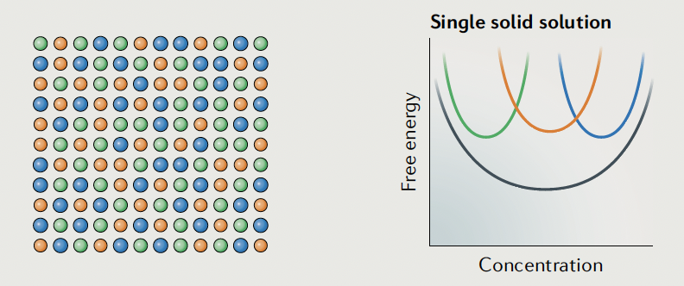
HEAs
The ‘normal’ alloying strategy adds relatively small amounts of secondary elements to a primary element
The combination of multiple principal elements in high concentrations to create new materials yields HEAs
It was theorized that the presence of multiple elements in near-equiatomic proportions would increase the configurational entropy of mixing by an amount sufficient to deter the formation of potentially harmful intermetallics
These can also be called multi-component alloys, compositionally complex alloys, and multi-principal-element alloys (delineations between the groups exist)

Slide 5
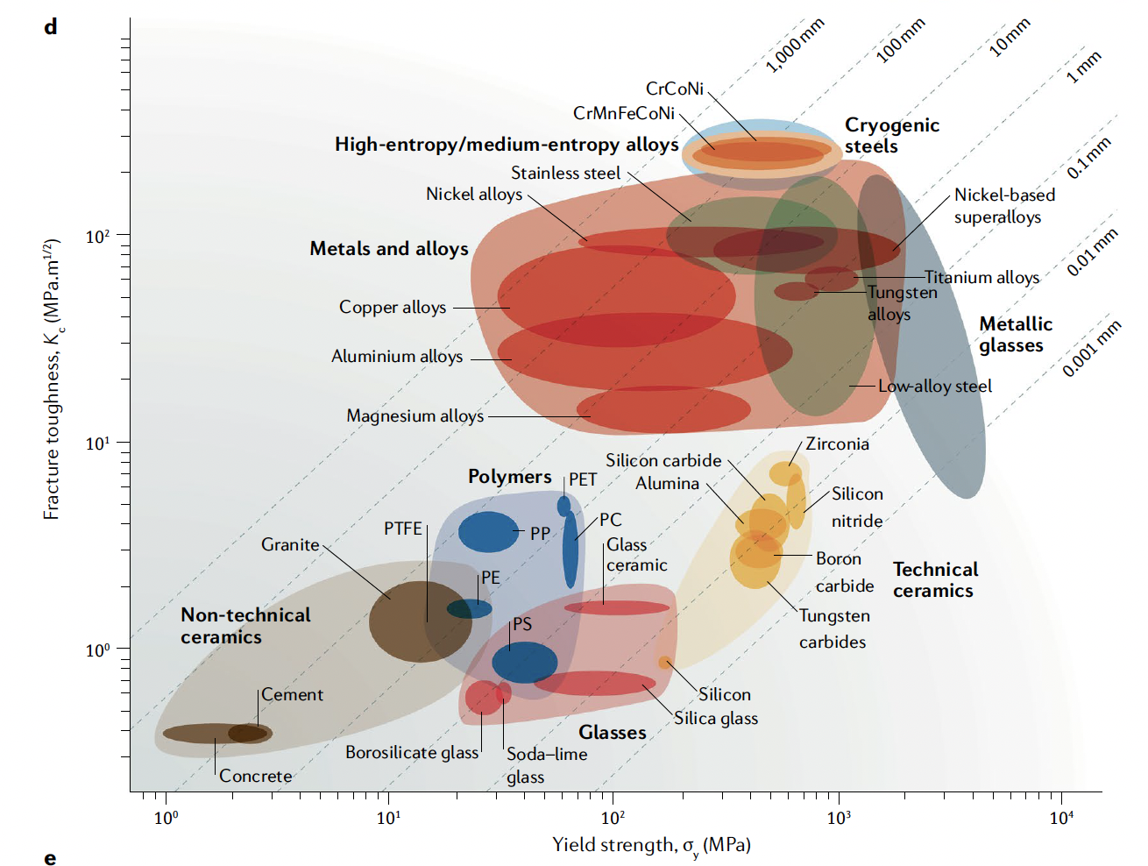
High strength and high ductility
HEAs have numerous appealing properties, such as great strength, great hardness, resistance to corrosion, fracture and fatigue resistance, and high-temperature stability
The concept of solid-solution strengthening is that solute atoms impede the motion of dislocations, increasing the yield strength
In HEAs, there is no single solute, and thus the local disorder/distortion acts as a strong barrier to dislocation motion

Slide 6
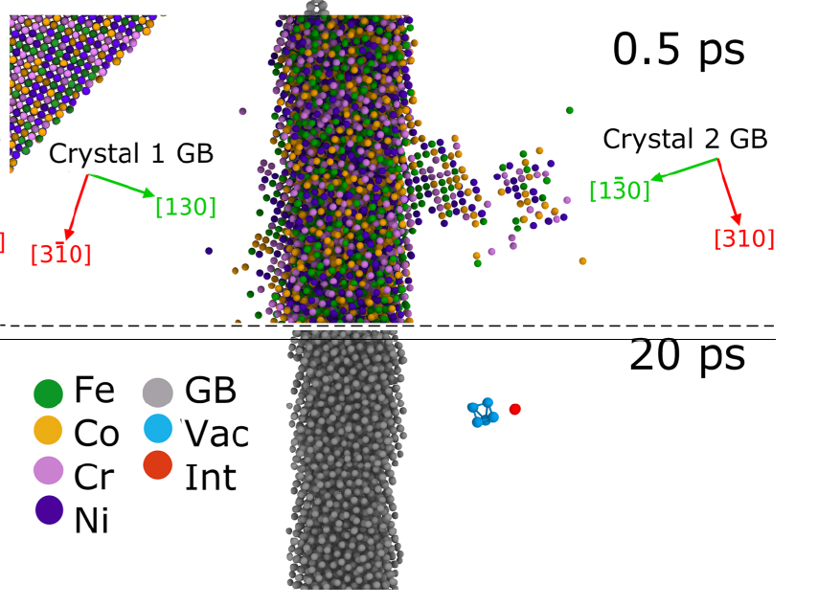
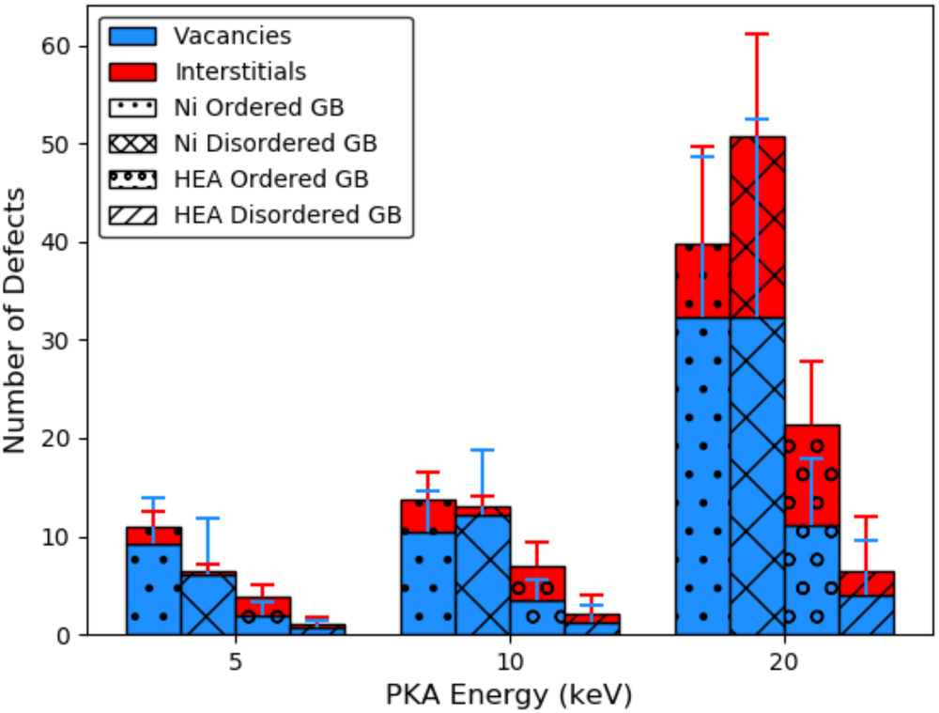
HEAs and Radiation Damage
HEAs may also be particularly suitable for high-fluence irradiation applications because of their radiation tolerance
This is related to severe lattice distortions or atomic-level stress caused by mismatches in atom size between the principal elements
This slows diffusion, prevents defect clustering, and promotes recombination
Grain boundaries are natural defect sinks and exist in all materials, but in HEAs the additional compositional complexity increases their efficiency in defect absorption

Slide 7
Notable HEAs
Most studied HEAs are either FCC or BCC based alloys
Cantor alloy: FCC CrMnFeCoNi, this is largely recognized as the first HEA, and can be stabilized as a single-phase FCC
High strength and high ductility that both increase with decreasing temperature
Fractures transgranularly through microvoids
Has been the basis for development of many HEAs, including non-equimolar HEAs with increased twinning-induced plasticity (TWIP)
BCC TiZrHfNbTa alloy
Significantly less is known on BCC HEAs
Comparable high strength to Cantor alloy (yield strength ~1 GPa), but ductility limited to 10-20%
Similar to FCC HEAs, TWIP and TRIP (transformation induced plasticity) are both active and provide ductility

Slide 8
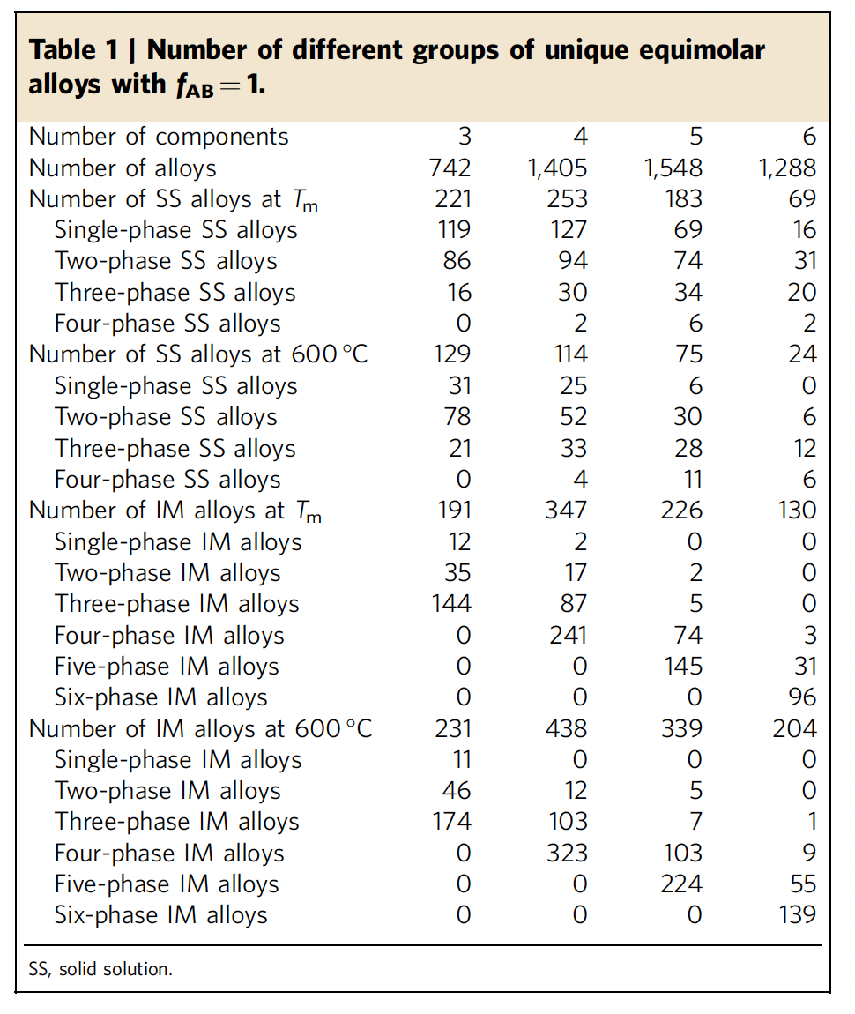
CALPHAD Screening of HEAs
CALPHAD (CALculation of PHAse Diagrams) fits Gibbs energy to experimental and first-principles data on binary and ternary systems, then extrapolates them to predict equilibrium phase stability in multicomponent alloys
With so many possible compositions, CALPHAD is used to explore phase stability and the potential for intermetallic formation before alloys are made
Senkov et al. screened >130,000 alloy systems, keeping only those whose binaries were fully assessed, which excluded >95%
Nuclear example: screening for low neutron cross-section BCC alloys yielded Al_{9.5}Mo_{4.7}Nb_{20.2}Ti_{4.6}Zr_{61.0}, single-phase BCC as cast

Slide 9
CALPHAD Screening of HEAs
Single-phase solid solutions become rarer as elements are added: 16% of 3-element systems, but only 1.2% of 6-element systems
Configurational entropy grows as ln(N), but the number of element pairs grows as N(N−1)/2, and one intermetallic-forming pair is enough for intermetallic formation
Want to avoid intermetallics, as they are typically brittle and hard, reduce ductility
CALPHAD predicts equilibrium, while irradiation drives segregation and precipitation away from equilibrium, thus, still need irradiation testing on candidate alloys

Slide 10
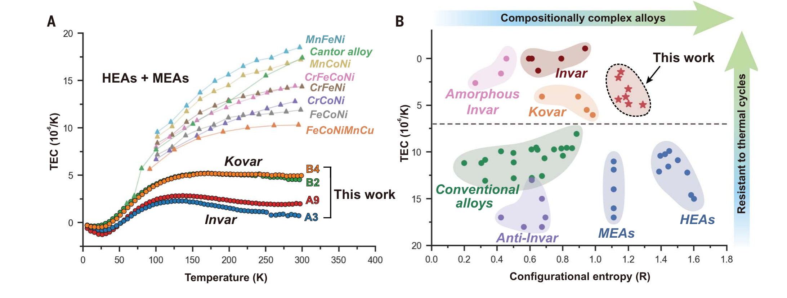
Machine Learning for HEA Design
The compositional space of HEAs is far too large to explore by experiment, so machine learning is being applied to probe it
Models trained on existing alloy data predict phase and properties, and can feed a CALPHAD screen
Active learning couples ML with DFT, thermodynamics, and experiments: 17 new alloys were made related to a single study, yielding 2 Invar HEAs
Training data are mostly as-cast, unirradiated alloys, so radiation tolerance still relies irradiation testing
ML-designed Invar and Kovar HEAs: thermal expansion vs. temperature (A) and vs. configurational entropy (B). Rao et al., Science 378 (2022) 78

Slide 11
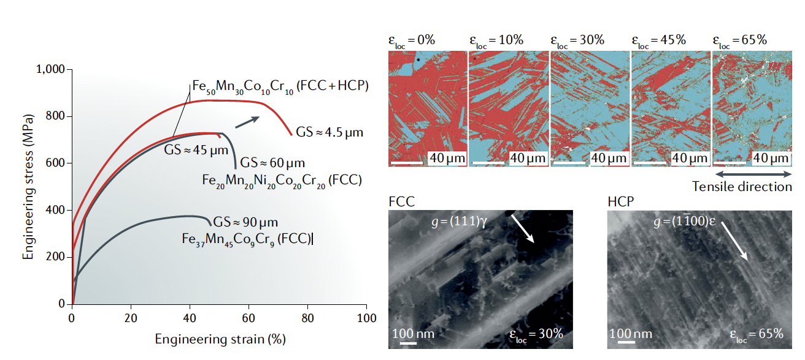
HEAs outlook/summary
This are still very new materials (only 20 years old) and much is still poorly understood, with experimental data scattered
Data for different grain sizes can be contradictory
CALPHAD and DFT are being employed to understand the phase space and the lattice distortion effects, respectively
Fabrication is still a severe challenge, as is cold-working or forming
But… they offer unique potential for high strength, high temperature, and radiation tolerant materials
Mechanical properties of the dual- phase, high- entropy , transformation- induced plasticity alloy Fe50Mn30Co10Cr10

Slide 12
Ni alloys

Slide 13
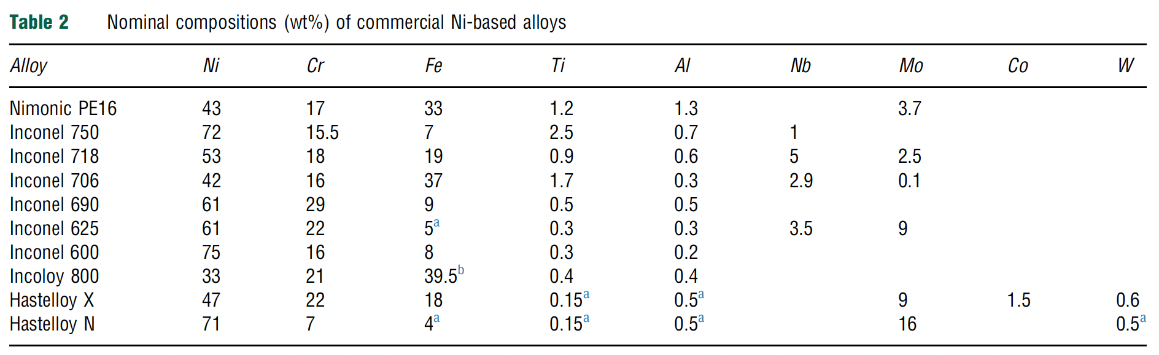
Ni Alloys
Generally resistant to corrosion and display limited mechanical property degradation at high T
Stress corrosion cracking (SCC/IASCC) is a key concern in LWR materials
He embrittlement is of major importance due to the Ni-58 neutron capture cross section which generates He
In fast reactor systems, Fe and Cr can also undergo n,alpha reactions
Ni alloys have been used in LWRs, but mainly in low-dose components, have seen some testing in fast reactors, and are of high interest in advanced reactors

Slide 14
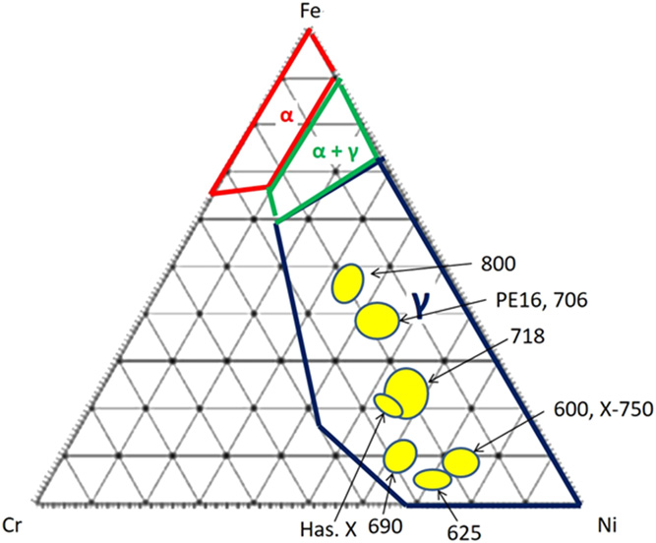
Structures
All commercial Ni alloys are gamma-phase FCC materials
Ternary phase diagram at right at 400C
Ni-alloys by rule have >28 wt% Ni
Fe and Cr are main alloy constituents, but Al, Ti, Nb, and Mo all have solubility and can be used to solid solution strengthen or precipitation harden
Most alloys are precipitation hardened to increased high temperature creep resistance

Slide 15
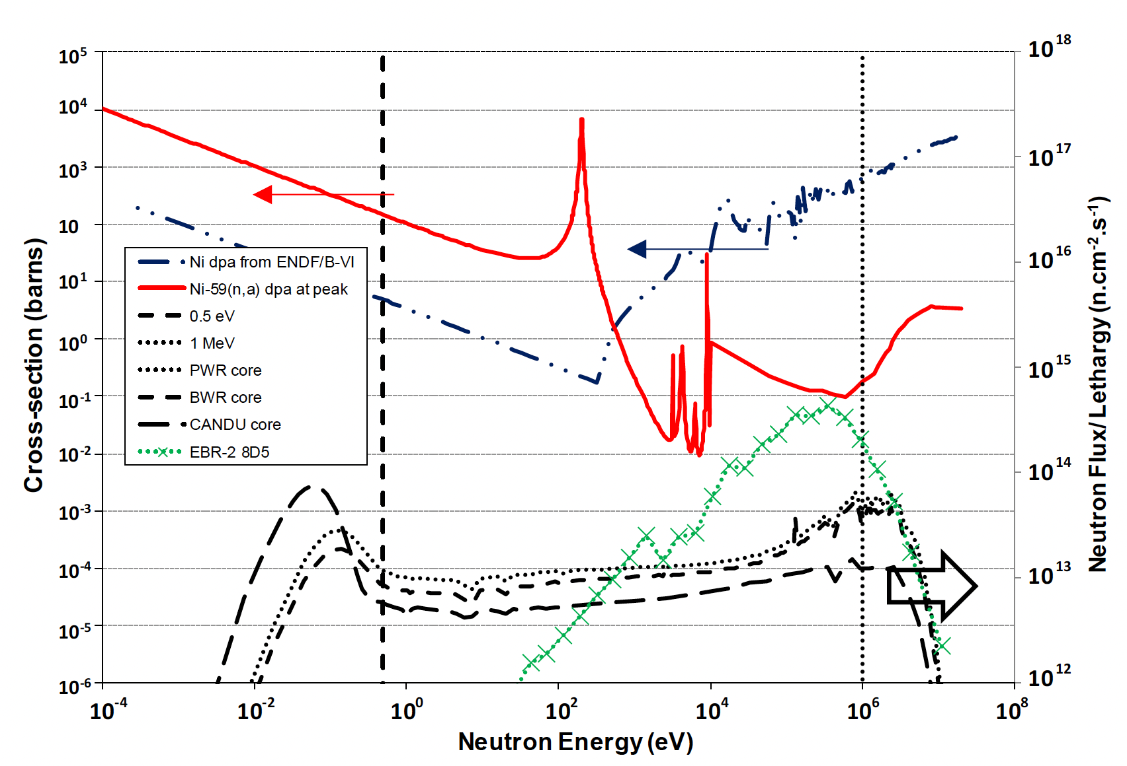
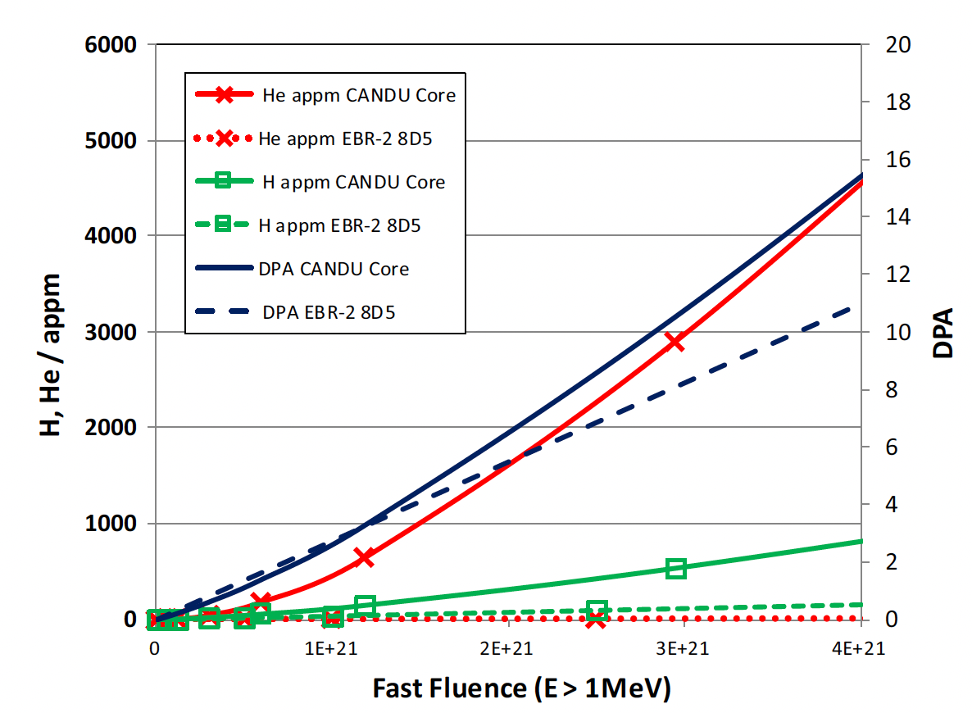
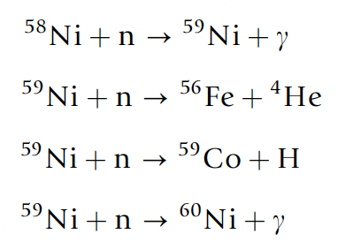
He generation
Large amounts of He and H can be produced due to high neutron dose
Ni alloys in CANDU reactors have a service lifetime of 20 years and can have >20000 appm He
The generation of He is also producing high energy PKAs which are introducing further damage into the system

Slide 16
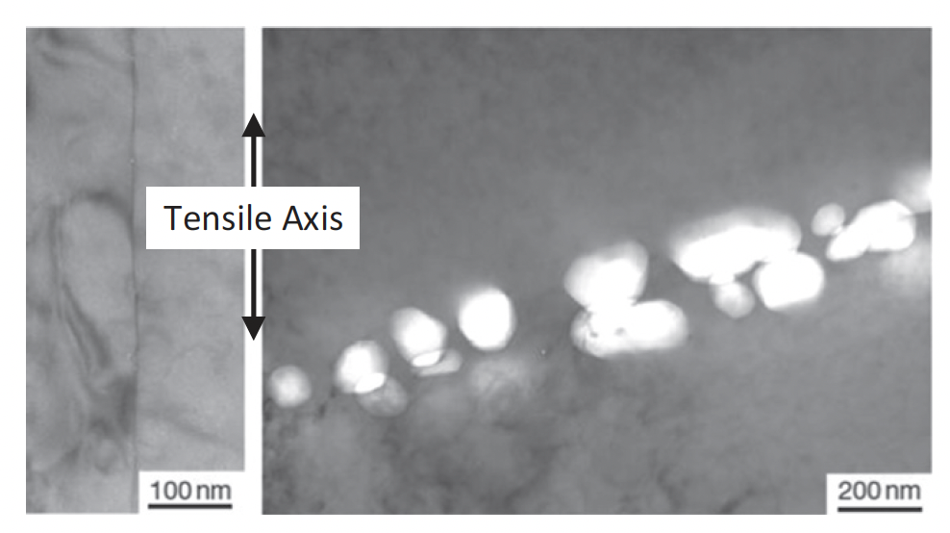
Void Swelling
The concept of void swelling is complicated by the generation of He, in that He bubbles and voids can form separately, or impact each others formation
In fast reactors, He generation is lower, about 1 appm/dpa, but He impacts on grain boundary bubbles have still been identified and are often associated with tensile stresses
Many examples that show high densities of He-stabilized grain boundary cavities in high flux reactors

Slide 17
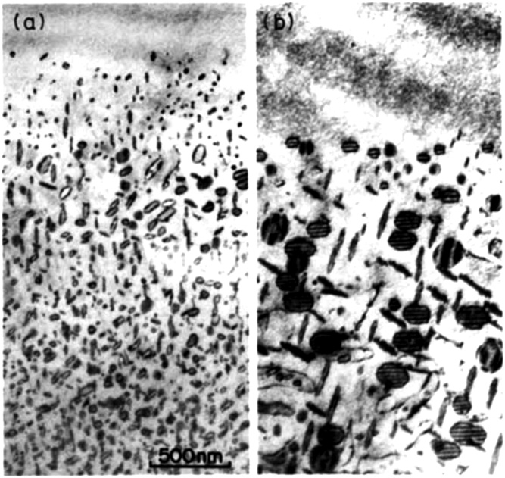
Dislocations
Large dislocation loops are observed at high temperatures expected in advanced reactors
Loop structures have been seen to be very sensitive to temperature controls during irradiation
T ramping
Constant T

Slide 18
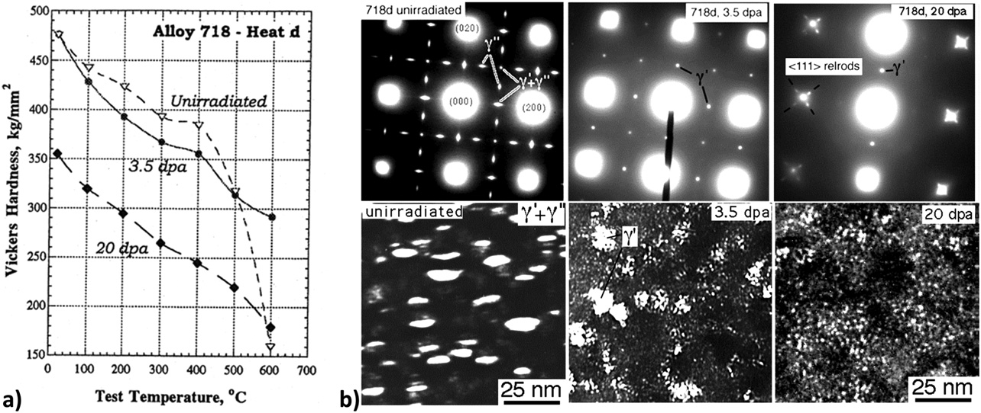
Precipitation
The primary precipitates that form are gamma’ (Ni3Al) and gamma’’ (Ni3Nb-type), where Ni can be replaced by Fe/Cr
These precipitates can be dissolved or dispersed during irradiation
There are competing ballistic and kinetic/thermodynamic factors at play
Higher temperatures allow more rapid diffusion, and the potential re-precipitation

Slide 19
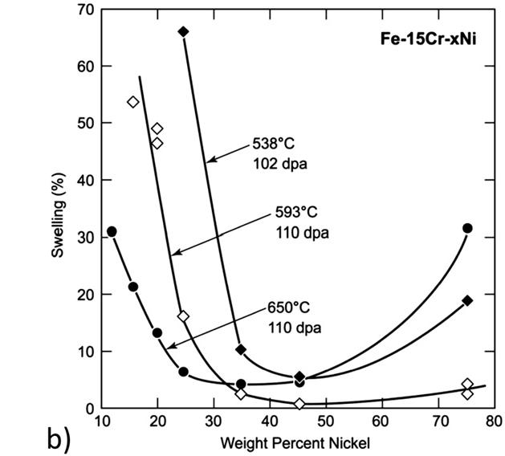
Swelling
Ni alloys generally show significantly improved resistance to swelling compared to SS
The presence of gamma’ precipitates is believed to a factor in the swelling resistance
Alloying species are expected to have the primary effect on swelling behavior, modifying local strain and vacancy biases via the inverse Kirkendall effect
neutron irradiated in a fast reactor to about 100 dpa

Slide 20
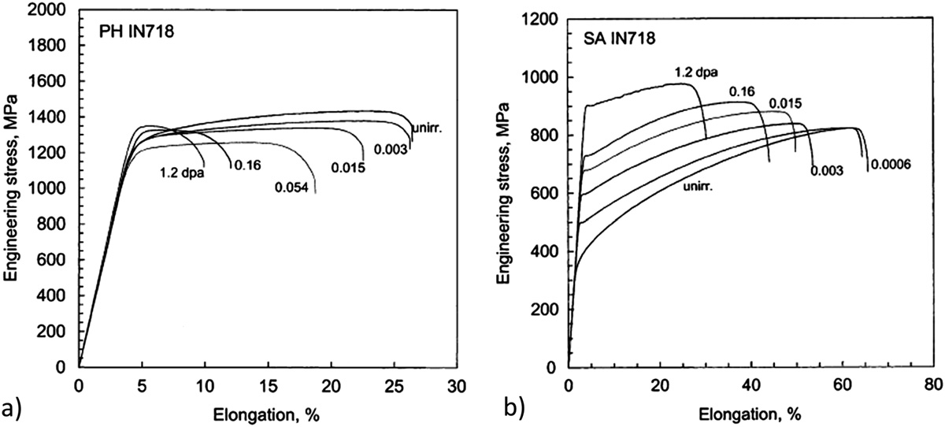
Irradiation Hardening
Ni alloys can generally be categorized into two classes: solution-annealed (SA) or precipitation hardened (PH)
The irradiation response is very different in these two classes
PH materials irradiated at low temperatures (below 100C) and low doses exhibit reduced ductility, but minimal hardening
SA materials exhibit substantial hardening in addition to a reduction in ductility

Slide 21
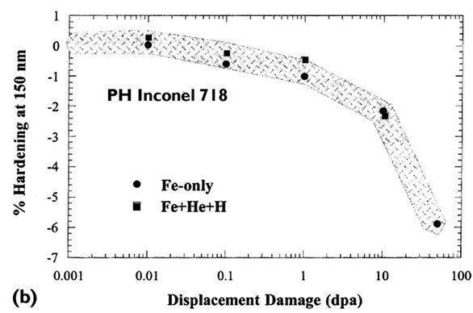
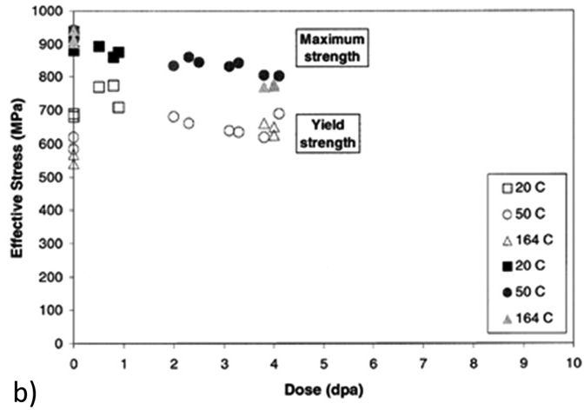
Higher Doses
For PH materials, after an initial increase in RT yield and UTS at low doses, further irradiation can result in a gradual decrease in strength
This has also been seen in PH-SS at elevated temperatures
This does not occur for SA Ni alloys
Softening due to dislocation recovery is likely the effect at high temperatures
At low T, this is likely due to precipitate dissolution

Slide 22
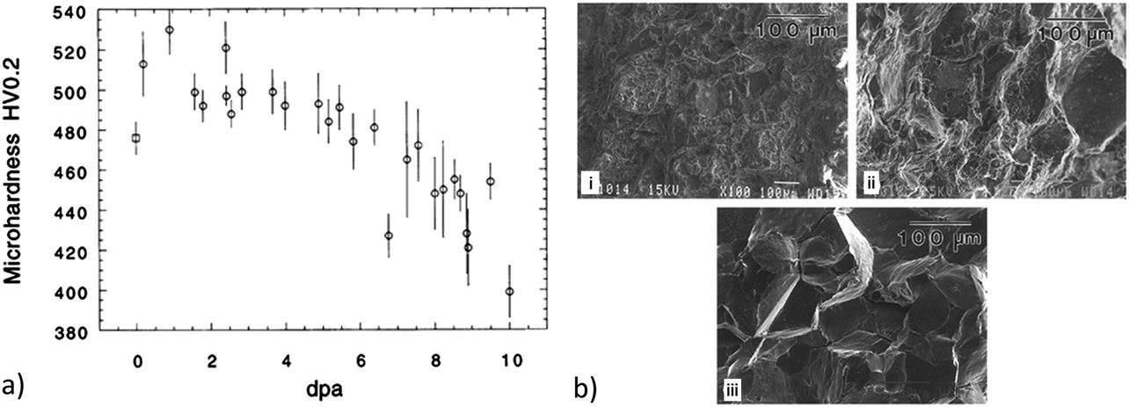
Embrittlement
Despite softening, ductility continues to decrease, embrittling the PH Ni alloy
There is a change from ductile intra-granular to brittle inter-granular failure with increasing dose at low T
This is likely related to He generation, stabilization of He grain boundary bubbles, and embrittlement
Thus, separate phenomena are leading to softening and embrittlement simultaneously
This knowledge base is built on ion irradiations, and some effects may not fully transfer to fast reactor systems

Slide 23
Ni Alloys Summary
Excellent high temperature behaviors, resistant to corrosion, reasonably compatible with molten salt, water, liquid Na
Ni transmutation is an issue which generates He, which can lead to embrittlement (bigger issue in thermal reactors)
Ni alloys are at least 28 wt% Ni, have an FCC phase, are either solid solution strengthened, or precipitation hardened (mostly PH)
gamma’ and gamma’’ precipitates provide strength, hardening, and swelling resistance
Alloys can soften with increased dose due to recovery of cold work at high T, but lose their ductility with increasing dose
Don’t have enough good data on irradiation effects in fast reactor environments

